Slide 1



Networking Project for Local Educational Institute

Slide 2
Project requirement
People Benefited:
200 students
25 teachers
12 marketing and administration staff
5 higher managers
3 computer network administrators
Devices must be linked together:
50 student lab computers
35 staff computers
3 printers
3 servers
Device allocation in institute building:
3 floors
all computers and printers are on the ground floor apart from the IT labs.
One IT lab is located on the first floor and another located on the second floor.
Data Centre with 3 servers is in 3rd floor.
Network Requirements:
Provide Quality of Service
Ensure network security
Ensure network scalability
Minimize data flow latency

Slide 3
Building a Local Area network can fulfill the networking requirement of institute
Advantages of implementing LAN for institute
it has software application sharing
easy and cheap communication
centralized data
data security and internet sharing
This LAN design created by using Tree topology
Advantages of Tree topology:
Easy to expand the network.
Fault detection is easy.
Point to point wiring for each device.
Disadvantages of Tree topology:
Difficult to configure.
If backbone break, whole network gets fail.
Expensive.

Slide 4
Resource Allocation
Individuals | Block | Floor | Resources
Higher Administration | - | Ground | Computers – 5 Printer - 1
Network Administrators | - | Ground | Computers - 3
Marketing and Administration staff | - | Ground | Computers – 12 Printer - 1
Teachers’ | - | Ground | Computers – 15 Printer - 1
Students | IT Lab 1 | 1st | Computers - 25
Students | IT Lab 2 | 2nd | Computers - 25
- | Data Center | 3rd | Servers - 3

Slide 5
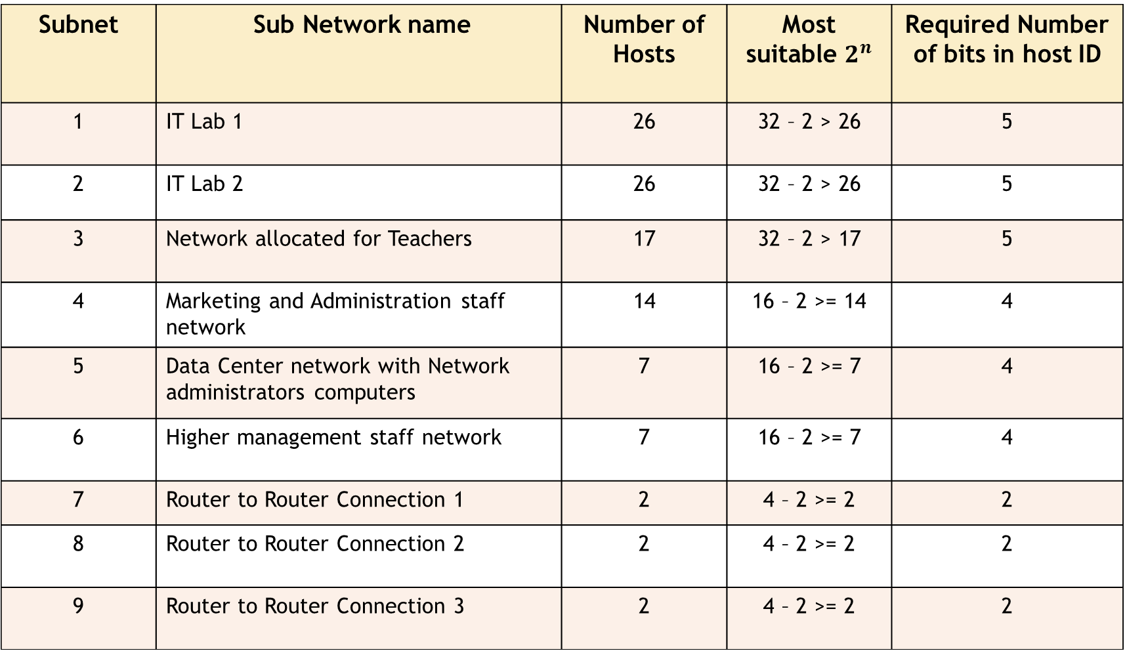
Sub Networks
Subnet | Sub Network name | Number of Hosts | Most suitable $2^{n}$ | Required Number of bits in host ID
1 | IT Lab 1 | 26 | 32 – 2 > 26 | 5
2 | IT Lab 2 | 26 | 32 – 2 > 26 | 5
3 | Network allocated for Teachers | 17 | 32 – 2 > 17 | 5
4 | Marketing and Administration staff network | 14 | 16 – 2 >= 14 | 4
5 | Data Center network with Network administrators computers | 7 | 16 – 2 >= 7 | 4
6 | Higher management staff network | 7 | 16 – 2 >= 7 | 4
7 | Router to Router Connection 1 | 2 | 4 – 2 >= 2 | 2
8 | Router to Router Connection 2 | 2 | 4 – 2 >= 2 | 2
9 | Router to Router Connection 3 | 2 | 4 – 2 >= 2 | 2

Slide 6
IP Addressing Plan
By considering network scalability class B private addresses 172.18.0.0 to 172.18.255.255 are used.
Dynamic NAT is implemented for internet connection.
Avalable IP addresses count - 65536.
Request IP address count for current device – 97.
VSLM will be used for allocating IP addresses for devices.
last 7 avalable bits of the 172.18.0.0 / 16 are used to fulfill the current requement.
Remaing left most bits can be used for subnets in future.

Slide 7
172 . 18 . 0 . 0 / 16
1010 1100 . 0001 0010 . 0000 0000 . 0000 0000
In first three subnets,required host counts are 26, 26, 17 respectively.
All those host requiement can be fulfilled by allocating 5 bits for host portion.
1010 100 . 0001 0010 . 0000 0000 . 0000 0000
Four subnets can be created considering last 2 bits of subnet ID.
172.18.0. 0 /27
172.18.0.32/27 Can be used for first three subnets
172.18.0.64/27
172.18.0.96/27 Can be used for further subneting

Slide 8
172 . 18 . 0 . 96 / 27 1010 1100 . 0001 0010 . 0000 0000 . 0110 0000
Next requment is 14 hosts for network 4 and it can be fulfilled by allocating 4 host bits .
1010 1100 . 0001 010 . 0000 0000 . 0110 0000 /28 can be used for network 4
172.18.0.96 / 28
1010 1100 . 0001 010 . 0000 0000 . 0111 0000 /28 can be used for further subnetting
172.18.0.112 / 28

Slide 9
Next ,two subnets are needed that each has 7 hosts for network 5 and 6.
To have 7 hosts, 4 host bits are required.
Two subnets can be created as follows.
1010 1100.0001 0010.0000 0000.0111 0000 /28
172.18.0.112 /28
1010 1100.0001 0010.0000 0000.1000 0000 /28
172.18.0.128 /28
Can be used for network 5
Can be used for network 6

Slide 10
At last,there network that each has 2 hosts need to be created for router-to router connection.
1010 1100 .0001 0010.0000 0000 .1001 0000 / 30
1010 1100 .0001 0010.0000 0000 .1001 0100 / 30
1010 1100 .0001 0010.0000 0000 .1001 1000 / 30
172.18.0.144/30 network 7
172.18.0.148/30 network 8
172.18.0.152/30 network 9

Slide 11
Device | Interface | IP Address | Subnet Mask | Default gateway
Router RGF1 | Fa0/0.10 Fa0/0.20 Fa1/0 Se2/0 Se3/0 | 172.18.0.113 172.18.0.97 172.18.0.65 172.18.0.154 172.18.0.150 | 255.255.255.240 255.255.255.240 255.255.255.224 255.255.255.252 255.255.255.252 | - - - - -
Router RGF2 | Fa4/0 Se2/0 Se3/0 Se6/0 | 172.18.0.121 172.18.0.145 172.18.0.153 198.116.215.40 | 255.255.255.248 255.255.255.252 255.255.255.252 255.255.255.0 | - - - -
Router R1F1 | Fa 0/0 Fa 1/0 Se 2/0 Se 3/0 | 172.18.0.1 172.18.0.33 172.18.0.146 172.18.0.149 | 255.255.255.224 255.255.255.224 255.255.255.252 255.255.255.252 | - - - -
Server 3F1 | Fa0 | 172.18.0.132 | 255.255.255.240 | 172.18.0.129
Server 3F2 | Fa0 | 172.18.0.133 | 255.255.255.240 | 172.18.0.129
Server 3F3 | Fa0 | 172.18.0.134 | 255.255.255.240 | 172.18.0.129
Printer GF1 | Fa0 | 172.18.0.118 | 255.255.255.248 | 172.18.0.113
Printer GF2 | Fa0 | 172.18.0.74 | 255.255.255.224 | 172.18.0.65
Printer GF3 | Fa0 | 172.18.0.108 | 255.255.255.240 | 172.18.0.97

Slide 12
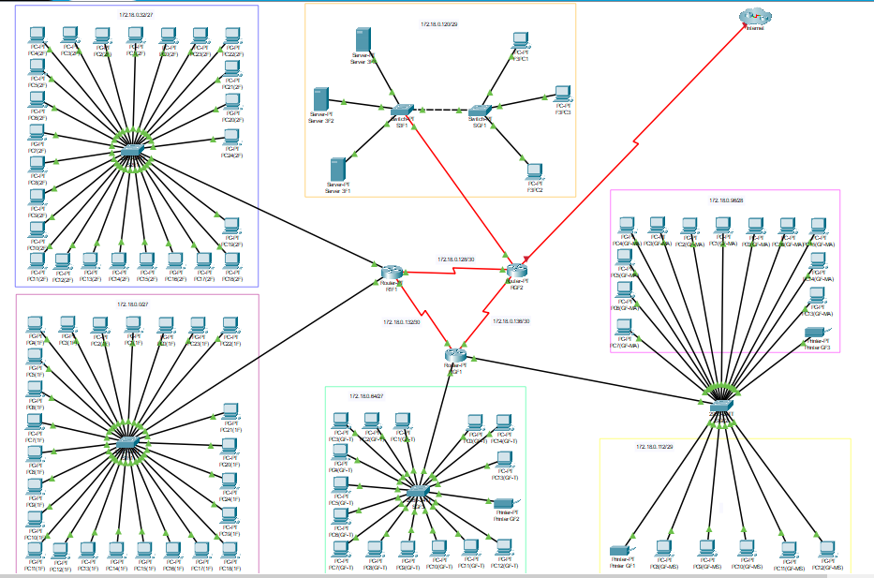
Logical Diagram

Slide 13
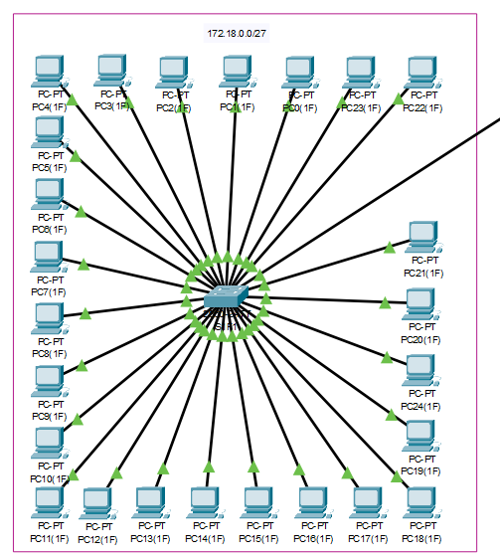
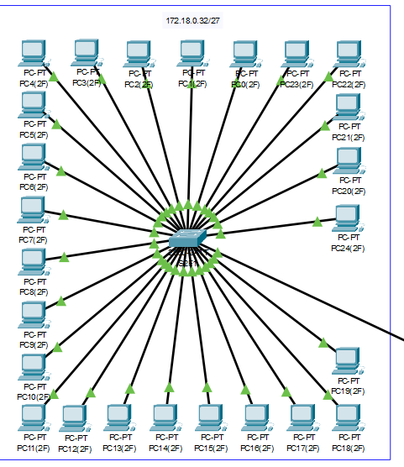
IT Lab 1
IT Lab 2

Slide 14
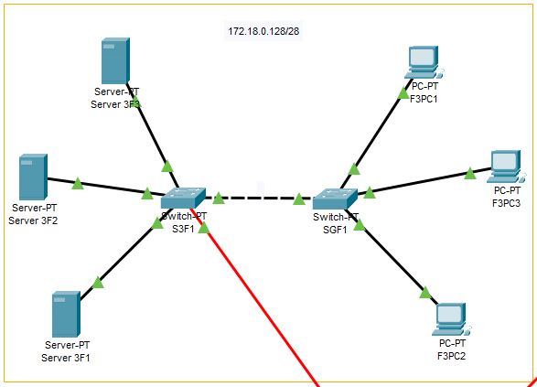
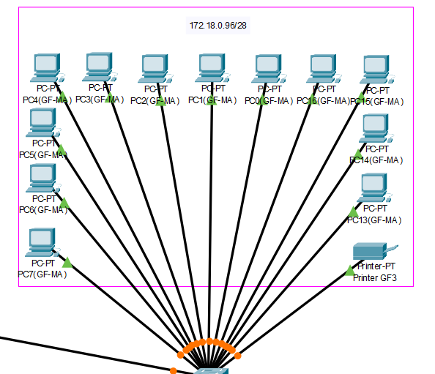
Data Center network with Network administrators computers
Marketing and Administration staff network

Slide 15
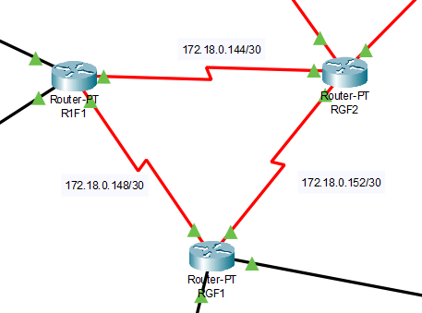
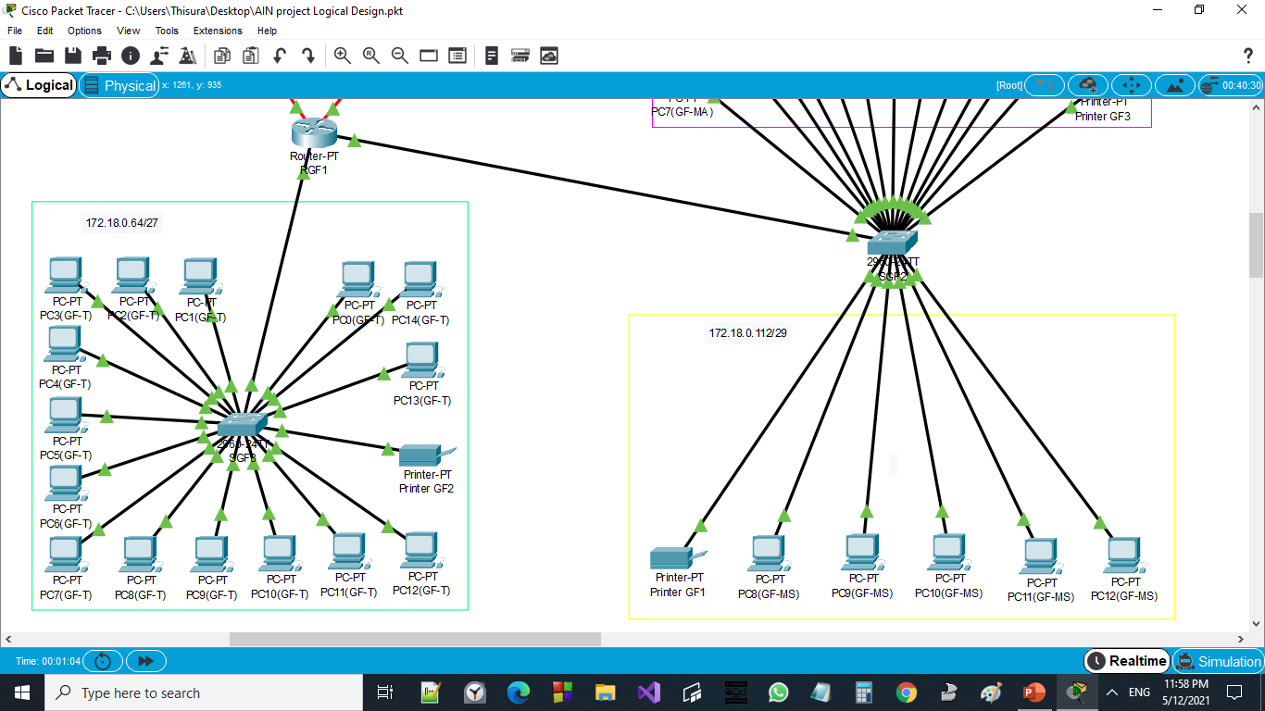
https://www.netacad.com/courses/packet-tracer
Router Connectivity
Network allocated for Teachers
Higher management staff network

Slide 16
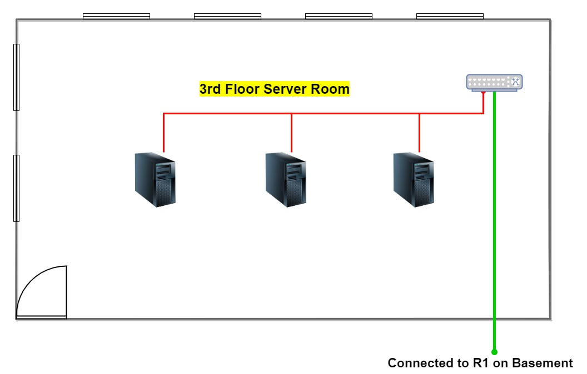
Physical Design

Slide 17
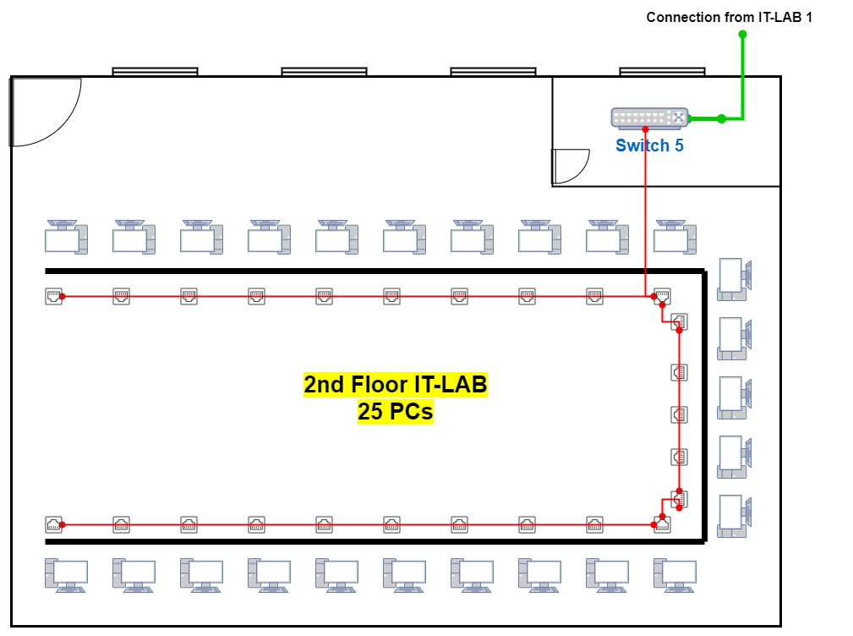

Slide 18
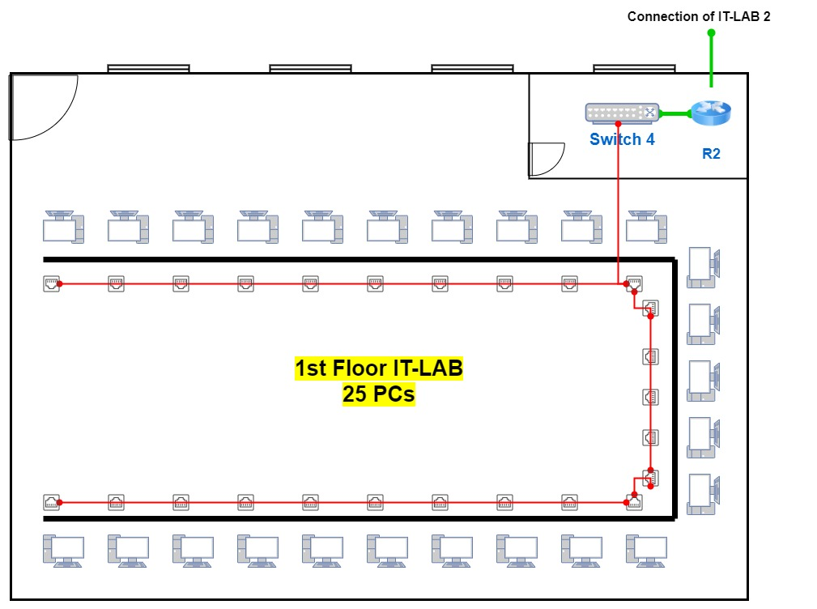

Slide 19
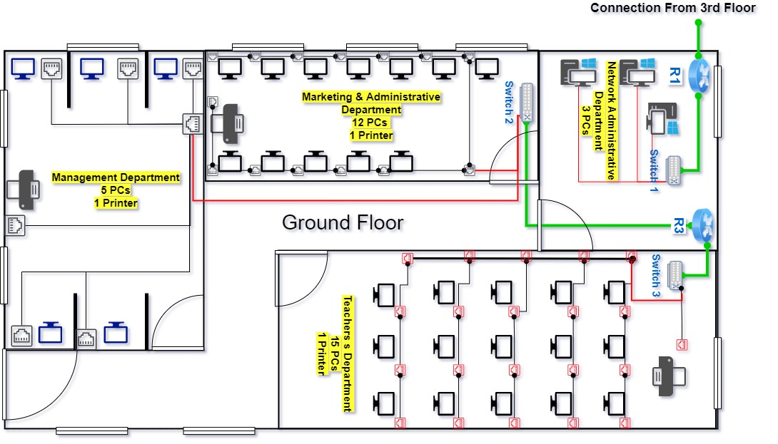

Slide 20
Network Configuration
DHCP is used to assign IP addresses to devices
dhcp pool - ITLab1
network 172.18.0.0 255.255.255.224
default-router 172.18.0.1
dhcp pool - ITLab2
network 172.18.0.32 255.255.255.224
default-router 172.18.0.33
dhcp pool - Marketing&Administration
network 172.18.0.96 255.255.255.240
default-router 172.18.0.97
dhcp pool - Teachers'Net
network 172.18.0.64 255.255.255.224
default-router 172.18.0.65
dhcp pool - HigherManagement
network 172.18.0.112 255.255.255.240
default-router 172.18.0.113
2 VLAN are used for seperate higer magement subnet and marketing subnet
10 HigerManagement
Switch ports: Fa0/12, Fa0/13, Fa0/14, Fa0/15, Fa0/16, Fa0/17
20 Marketing$Administration
Switch Ports: Fa0/1, Fa0/2, Fa0/3, Fa0/4, Fa0/5, Fa0/6, Fa0/7, Fa0/8, Fa0/9, Fa0/21, Fa0/22, Fa0/23, Fa0/24

Slide 21
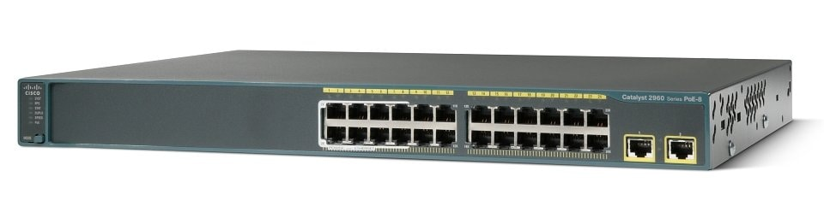
Device Selection
Cisco 2960 series 24TT switch
Cisco 2960-24TT switch consists of Fast Ethernet 24 ports and 2 Gigabit Ethernet Ports.
The switch has both full-duplex and half-duplex communication modes.
Since this is a Rack-mountable switch, it make easy whenever scaling is needed.
HTTP, HTTPS, RMON 1, RMON 2, RMON 3, RMON 9, SNMP 1, SNMP 2, SNMP 2c, SNMP 3, SSH, TFTP and Telnet are the remote management protocols.
MAC Address Table Size: 8K entries
ARP support, Access Control List (ACL) support, BOOTP support, Broadcast Storm Control, DHCP snooping, Dynamic Trunking Protocol (DTP) support, IGMP snooping, IPv6 support, Link Aggregation Control Protocol (LACP), MAC Address Notification, Multicast Storm Control, Multiple Spanning Tree Protocol support.
Price – 600 to 700 USD.
Reference: https://www.router-switch.com/WS-C2960-48TT-L-p-429.html

Slide 22
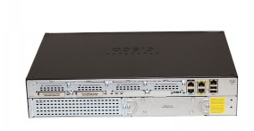
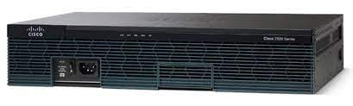
Cisco 2911 Router
3 integrated 10/100/1000 Mbps Ethernet ports.
1 service module slot.
4 enhanced high-speed WAN interface card slots.
2 onboard digital signal processor (DSP) slots.
1 Internal Service Module slot for application services.
Fully integrated power distribution to modules supporting 802.3af Power over Ethernet (PoE) and Cisco Enhanced PoE.
Price - 1400-1600$.
Security
Embedded hardware-accelerated VPN encryption for secure connectivity and collaborative communications Integrated threat control using Cisco IOS Firewall, Cisco IOS Zone-Based Firewall, Cisco IOS IPS, and Cisco IOS Content Filtering
Identity management using authentication, authorization, and accounting (AAA) and public key infrastructure.
Voice
High-density-packet voice DSP module, optimized for voice and video support.
Standards-certified VoiceXML browser services.
Cisco Unified Border Element capabilities.
Cisco Unity Express voicemail support.
Reference: https://www.cisco.com/c/en/us/products/routers/2911integrated-services-router-isr/index.html

Slide 23
Choose of Routing Protocols
Interior Gateway Protocols are utilized since this network is managed by a single authority.
Interior Gateway protocols can be divided into Distance vector protocol group and Link state protocol group.
Therefore, Distance vector Protocols is chosen for this network.
From Distance Vector protocols, we will be using RIP version2 and EIGRP.
Distance Vector | Link State
Routers communicate with neighbor routers advertising network as measures of distance and vector. | Routers communicate with all other routers. High bandwidth usage.
Convergence time not cause problems | Convergence time is crucial
Minimum administer knowledge | High administer knowledge
Suitable for simple and small networks | Suitable for large networks

Slide 24
Routing Protocol comparison
RIPv2 | EIGRP
standardized protocol It’s VLSM compliant Provides fast convergence Sends triggered updates when the network changes Works with snapshot routing – making it ideal for dial networks Max hop-count of 15, due to the ‘count-to-infinity‘ vulnerability No concept of neighbors Exchanges entire table with all neighbors every 30 seconds (except in the case of a triggered update) | simple protocol to understand and deploy Provides extremely quick convergence times Easy transition to IPv6 with multi-address family support for both IPv4 and IPv6 networks. Superior scaling of Interior Gateway Protocol (IGP) for large dynamic multipoint (DM) VPN deployments Very fast rapid convergence times for changes in the network topology Only routing table changes, not the entire routing table, are propagated, when a change occurs More efficient use of links, through equal cost multipath (ECMP) and unequal cost load sharing EIGRP is still distance vector routing protocol and only relies on routed provided by directly connected neighbor.

Slide 25
Protocol | Average round trip time | Source → Destination
EIGRP | 7ms | F3PC2 to PC6(GF-MA)
RIP | 17ms | F3PC2 to PC6(GF-MA)
EIGRP | 4ms | F3PC3 to PC24(2F)
RIP | 7ms | F3PC3 to PC24(2F)
EIGRP | 5ms | F3PC1 to PC20(1F)
RIP | 7ms | F3PC1 to PC20(1F)
EIGRP | 8ms | PC8(GF-MS) to PC24(2F)
RIP | 9ms | PC8(GF-MS) to PC24(2F)
EIGRP | 10ms | PC7(GF-MA) to PC6(GF-T)
RIP | 8ms | PC7(GF-MA) to PC6(GF-T)
Average Time for all ,
EIGRP -> 7+4+5+8+10/5 = 6.8ms
RIP v2 -> 17+7+7+9+8/5 = 9.6ms
EIGRP is suggested as the most suitable routing protocol for this network.

Slide 26
Verification Test
Ping | Tracert
Test the network connectivity between devices. | Tracert also use for test connectivity between end points. Apart from that this command show several paths that packets takes from source to destination.
Ping using ICMP for checking the connectivity.
ping [-t] [-a] [-n count] [-l size] [-f] [-i TTL] [-v TOS] [-r count] [-s count] [-w timeout] [-R] [-S source address] [-p] [-4] [-6] <destination ip or hostname> | tracert [-d] [-h MaxHops] [-w TimeOut] [-4] [-6] <destination ip or hostname>

Slide 27
Bandwidth per user :
User | Bandwidth
Network Admin | High
Higher Management staff | High
Marketing and administration staff | Medium
Teacher | Medium
Student | Low

Slide 28
Security Requirements and Quality of Service
In all access level switches, switch port security is used.
● Maximum 1 mac address is allowed for one interface.
● Violation mode is set to shutdown.
All the unused ports in access level switches has been manually shut down.
ACL is used to control the access.
Access User | Higher Management staff Network | Marketing Staff Network | Teachers’ Network | Student Network | Network Admin Pc’s | Data Servers | Internet
Teacher | No | No | Yes | Yes | No | No | Yes
Higher Management staff | Yes | Yes | Yes | No | Yes | Yes | Yes
Network Admin | Yes | Yes | Yes | Yes | Yes | Yes | Yes
Student | No | No | No | Yes | No | No | Yes
Marketing staff | No | Yes | No | No | No | No | Yes

Slide 29
Maintenance Schedule
Task |  | Daily | Weekly | Monthly | Annually
System backups |  |  |  | ✓
Troubleshooting |  |  | ✓
Installing and configuring new devices. |  |  |  |  | ✓
Network | Check connections and cables. |  | ✓
 | Updating firewall operating system |  |  | ✓
 | Checking devices. (switches, routers, servers, printers..) | ✓
 | Network security | ✓
Servers | Check server log files | ✓
 | Apply necessary packs and updates |  | ✓
 | check backup |  |  | ✓
 | Software and hardware updates |  |  |  | ✓
PCs | Anti virus software checkups |  | ✓
 | Disk space utilization | ✓
 | Update services |  |  | ✓

Slide 30
Recommendations for Upgrades and Security Requirements
Administrators can currently login to PC’s by using telnet, it is good to ensure security by configuring SSH for remote login for Administrators.
There are less number of resources than people currently employed in institute, so adding shortcoming Pc’s are suggested.
It is good to have a backup routers for maximize redundancy.
Apply necessary changes to maintenance schedule according to the institute requirement in recommended.
It is good to add physical firewall when network is scaling and more and more users connecting to network.

Slide 31
Thank You !

